Slide 1
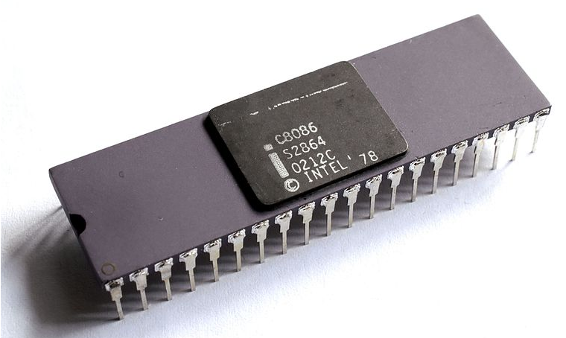
UNIT 4
MICROPROCESSOR
8086

Slide 2
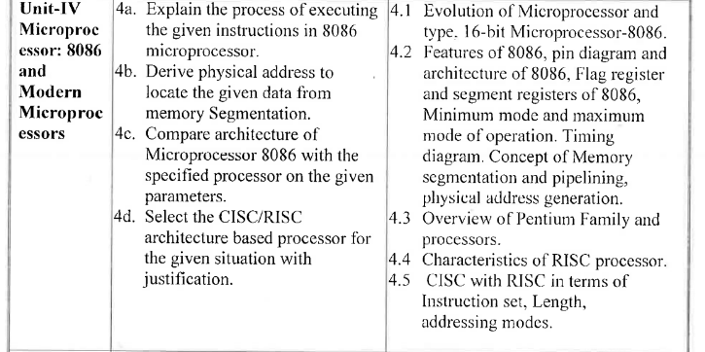

Slide 3
Microprocessor
A microprocessor is a computer processor where the data processing logic and control is included on a single integrated circuit.
The microprocessor contains the arithmetic, logic, and control circuitry required to perform the functions of a computer's central processing unit.
Microprocessor manipulates all calculation such as adding/subtracting with using ALU, control Unit, and Register Array. After executing the instructions store it into memory area, and finally send those output for displaying on the output devices such as computer monitor

Slide 4
Evolution of Microprocessor with its History
History of Microprocessor –
First microprocessor was developed by INTEL in 1971, and its name was Intel 4004. Intel 4004 is based on 4 bit processor; due to this it was not more popular. Intel 4004 was able to perform only addition/subtraction operation on 4 bit at once.
Intel was announced new Intel’s 8080 in 1974 for personal computer. It is based on 8 bit processor.
In 1976, Intel was designed 8085 processor but it was not new invention because 8085 microprocessor was updated version of 8080 microprocessor. In 8085 microprocessor, are attached two Enable/Disable Instructions, 3 interrupt pins and serial I/O pins.

Slide 5
In 1976, Intel was announced again new 8086 microprocessor. 8086 microprocessor is better to 8085 because it is based on 16 bit.
Later, Intel was designed other new 8087 microprocessor that was first math co-processor, and this processor was embedded into IBM PC.
Due to more effort of microprocessor’s companies, other new processor are come in market such as 8088,80286,80386,80486,Pentium II, Pentium III, Pentium IV and now Core 2Duo,Dual Core and Quad core processors.

Slide 6
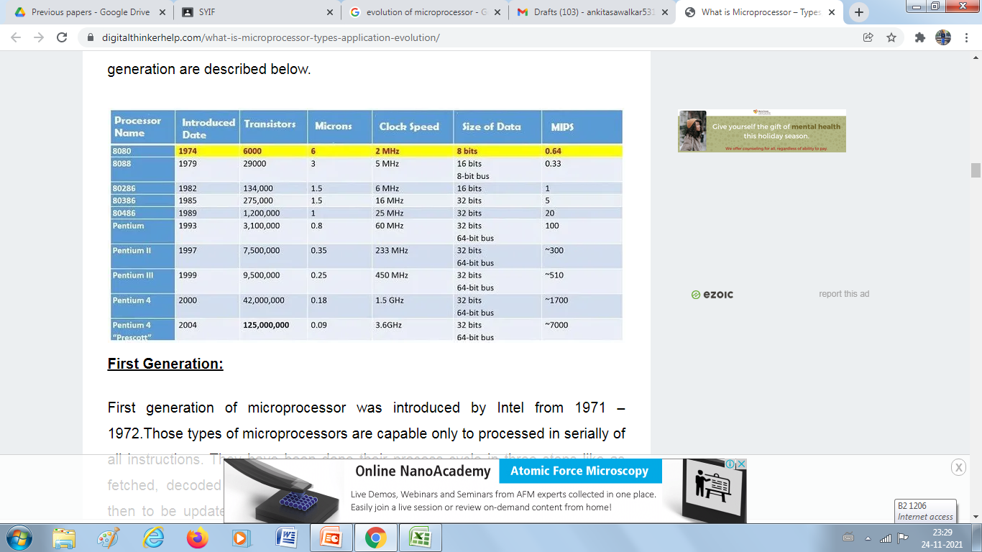

Slide 7

Applications

Slide 8
Features
1)It requires +5v power supply.
2)It has 20 bit address bus, can access 220 -1MB memory location.
3)16 bit data bus.
4)It is a 16 bit processor having 16 bit ALU, 16 bit registers.
5)It has instruction queue which is capable of storing 6 instruction bytes for faster processing.
6)It has pipelining, fetch and execute stage for improving performance.
7)It has 256 vectored interrupts.
8)Clock range is 5-10 MHz.

Slide 9
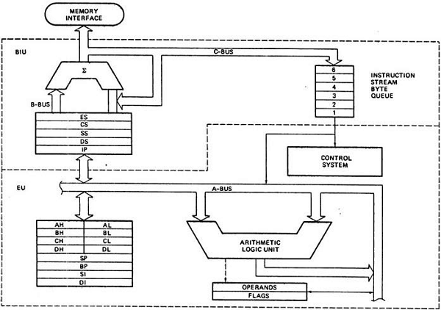
architecture

Slide 10
architectural block diagram
Intel 8086 is a 16 bit integer processor. It has 16-bit data bus and 20 bit address bus. The internal architecture of Intel 8086 is divided into two units,
1. Bus Interface Unit (BIU)
2. Execution Unit (EU).
BIU:
It handles all transfers of data and addresses on the buses for the execution unit.
Sends out addresses
Fetches instructions from memory.
Read / write data from/to ports and memory i.e. handles all transfers of data and addresses on the busses
OR
The BIU is responsible for the external bus operations. - It performs fetching, reading, writing for memory as well as I/O of data for peripheral devices.
EU:
Fetch instructions
Decodes instructions
Executes instructions

Slide 11
Execution Unit [EU]
The function of Execution unit are:
To tell where to fetch the instruction or data from.
To decode the instruction.
To execute the instruction.
Execution Unit:
Control unit: The EU contains the control circuitry to perform various internal operations
Arithmetic and Logic Unit (ALU): Execution unit has a 16 bit ALU, which performs arithmetic & logic operations on 8 bit as well as 16 bit data.
General purpose register unit: All general registers of the 8086 microprocessor can be used for arithmetic and logic operations. The general registers are: Accumulator register AL (8 bit), AX (AL & AH for 16 bit), Base register, Count register, Data register, Stack Pointer (SP), Base Pointer (BP), Source Index (SI), Destination Index (DI).
Flags: EU also contains 16 bit flag register where the status of result can be seen. It is a 16-bit register containing 9 1-bit flags: Overflow Flag
(OF), Direction Flag (DF). Interrupt-enable Flag (IF). Single-step Flag (TF), Sign Flag (SF), Zero Flag (ZF). Auxiliary carry Flag (AF), Parity Flag (PF), Carry Flag (CF).

Slide 12
Bus Interface Unit (BIU)
Memory Interface: The Bus Interface Unit (BIU) generates the 20-bit physical memory address and provides the interface with external memory
Instruction Byte queue:
(ROM/RAM). 8086 has a single memory interface. To speed up the execution, 6-bytes of instruction are fetched in advance and kept in a 6- byte Instruction Queue while other instructions are being executed in the Execution Unit (EU).
Segment registers:
There are four 16-bit segment registers, the code segment (CS). the stack segment (SS), the extra segment (ES), and the data segment (DS). The processor uses CS segment for all accesses to instructions
5) Adder:
referenced by instruction pointer (IP) register. 8086's BIU produces the 20-bit physical memory address by combining a 16-bit segment address with a 16-bit offset address using the adder circuit.

Slide 13
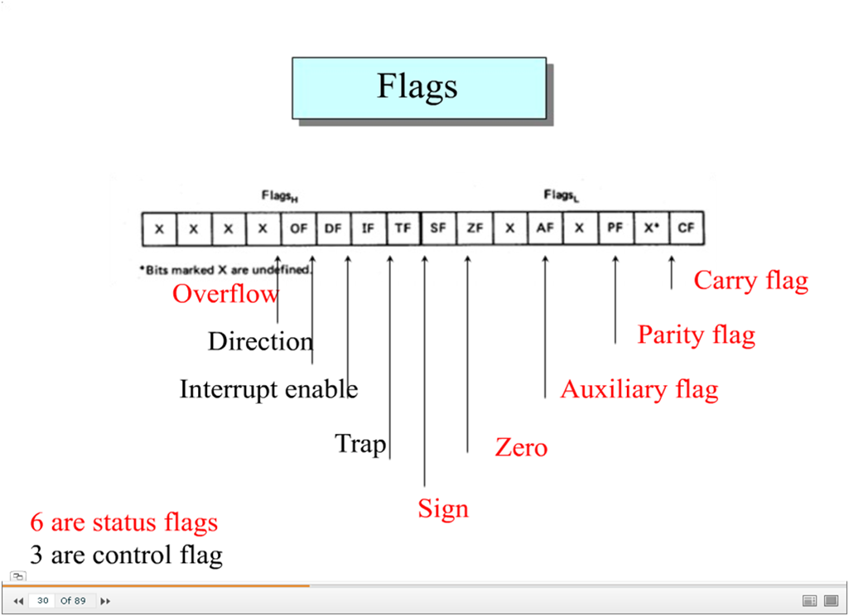
Use of Flag Register: Microprocessor 8086 has 16 bit flag register among which 9 bits are active. The purpose of flag register is to indicate the status of the processor Depending upon the value of result after any arithmetic and logical operation the bits become set (1) or reset (0).

Slide 14
Flag Register
Carry Flag (CF): Set 1 if there is carry out of MSB position.
Auxiliary Flag (AF): Set 1 if carry from lower nibble to upper nibble.
Parity Flag (PF): Set 1 if result contains even number of 1’s.
Zero Flag (ZF): Set 1 if result of arithmetic or logical operation is zero.
Sign Flag (SF): Set 1 if result of operation is negative.
Overflow Flag (OF): Set 1 if result is too large to fit in the numbers bits available to accommodate it.
Control Flags:
Trap Flag (TF): Set 1 if program can be run in single step.
Interrupt Flag (IF): Set 1 if INTR of 8086 is enabled.
Direction Flag (DF): Set 1 if string bytes are write or read from higher memory address to lower memory address.

Slide 15
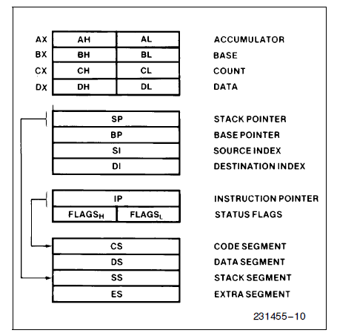
Register structure

Slide 16
General purpose registers of 8086
Execution Unit (EU) contains eight 16 bit general purpose registers named as AX, BX, CX, DX, SP, BP, SI and DI as shown in Fig. Out of these registers, AX, BX, CX and DX can be used either as eight 8-bit registers i.e. AL, AH, BL, BH, CL, CH, DL, DH or can be used as four 16-bit i.e. AX, BX, CX and DX. The AL register is called as 8 bit accumulator and AX is called as 16 bit accumulator.
In addition to the general purpose job, some register have special task such as
CX is normally used as a counter,
BX can be used as a pointer and
DX is used for I/O addressing to hold the I/O address in some instructions of the 8086 microprocessor.
The other registers in EU are SP, BP, SI and DI. SP and BP are pointer register, which holds 16-bit offset within the particular segment. SI and DI are the index registers.

Slide 17
Use of Segment Register: The 8086 has four segment register of 16 bit each. i.e. CS,DS,SS and ES. The code segment CS register used to address a memory location in the code segment of memory. The data segment point to data segment of memory where the data is stored the extra segment ES used to address the segment is additional data segment. The Stack segment SS register is used to point location in stack segment of the memory, used to store data temporarily on the stack.

Slide 18
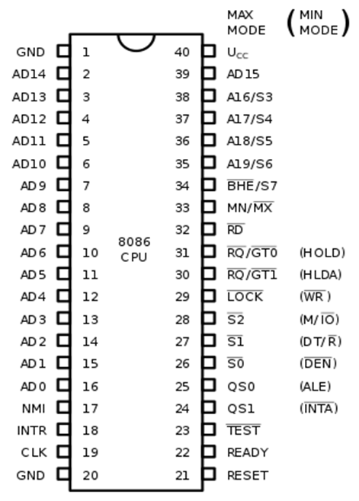

Slide 19
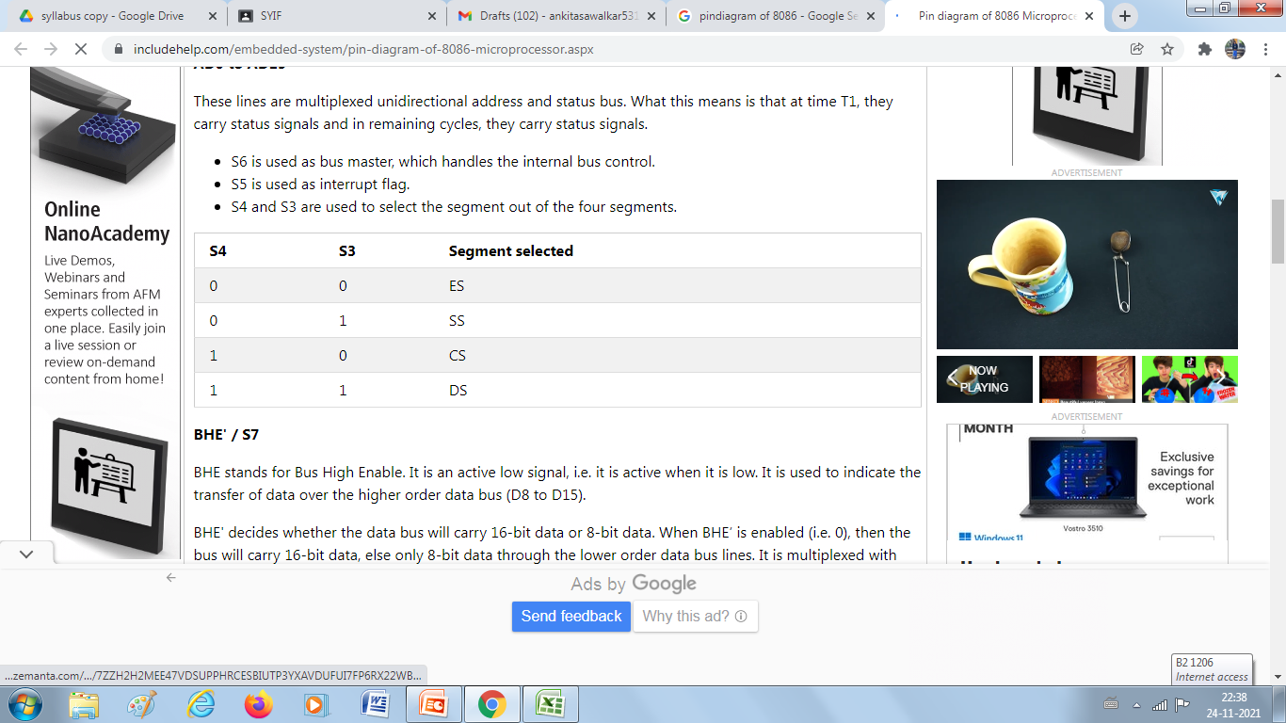
Pin Diagram
The 8086 microprocessor is a 40 pin IC in which there are 20 pins on each side of the IC. The diagram of the same is as follows:
1. AD0 to AD15
These lines are multiplexed bidirectional address/data bus. What this means is that during T1, they carry 16 bit address and in remaining cycles (T2,T3,T4), they carry 16 bit Data.
S6 is used as bus master, which handles the internal bus control.
S5 is used as interrupt enable status signal.
S4 and S3 are used to select the segment out of the four segments.

Slide 20
2. BHE' / S7 (Bus High Enable/Status)
BHE stands for Bus High Enable. It is an active low signal, i.e. it is active when it is low.
It is used to indicate the transfer of data over the higher order data bus (D8 to D15).
BHE' decides whether the data bus will carry 16-bit data or 8-bit data. When BHE’ is enabled (i.e. 0), then the bus will carry 16-bit data, else only 8-bit data through the lower order data bus lines.
It is multiplexed with status pin S7.
3.RD‘(Read)
It is a read signal used for read operation.
It is also an active low signal.
4. READY
This is an acknowledgment signal from the slower I/O devices or memory.
When high, it indicates that the device is ready to transfer data, else the microprocessor is in the wait state.

Slide 21
5.RESET
This signal is active High signal.
It is a system Reset.
When this signal goes high, processor enters into reset state and terminate the current activity and the program control returns to FFFF0_{H}.
6. INTR(Interrupt Request)
This pin is used to receive an interrupt request signal. It is a type of maskable (can be Avoid) interrupt.
7. NMI(Non-maskable Interrupt)
This is used for Non-Maskable Interrupt Request.
8. GND
There are two ground pins in the 8086, pin 1 and pin 20.
9. VCC
The pin 40 is for voltage input.

Slide 22
10.MN / MX'
This pin is used for minimum or maximum mode of the microprocessor.
When this pin is 1, the microprocessor works in minimum mode, and
when the pin is 0, the maximum mode is followed.
Minimum and maximum Mode Pins
Total 8 pins, from Pin 24 to pin 31 work differently for different modes (maximum or minimum).
11.TEST'
This is also an active low signal. This pin is used for wait instruction when the 8086 is connected with the 8087 microprocessor.
12. CLK(Clock Input)
This pin tells about the clock pulse.
This clock input provides the basic timing for processor operation and bus control activity.

Slide 23
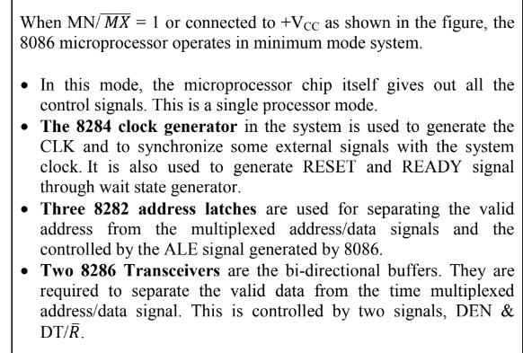
Minimum mode of Operation

Slide 24
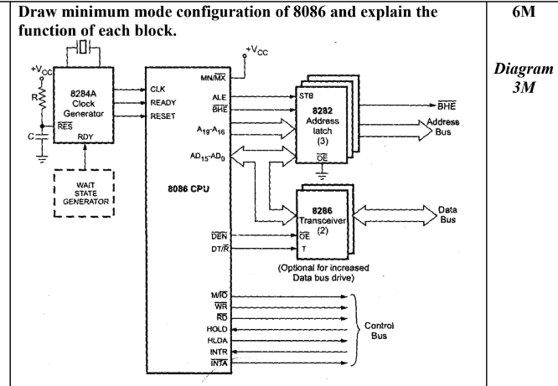

Slide 25
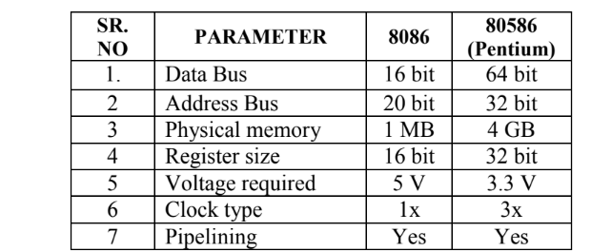
Compare 8086 & 80586

Slide 26
Physical Address & Effective Address
(i) Physical Address
Physical: The address given by BIU is 20 bit called as physical address. It is the actual address of the memory location accessed by the microprocessor.
(ii) Effective Address
Effective Address: Effective address or the offset address is the offset for a memory operand. It is an unassigned 16 bit number that gives the operand's distance in bytes from the beginning of the segment.
Operand= Operands in Microprocessor are the data contents on which the operation is to be performed.

Slide 27
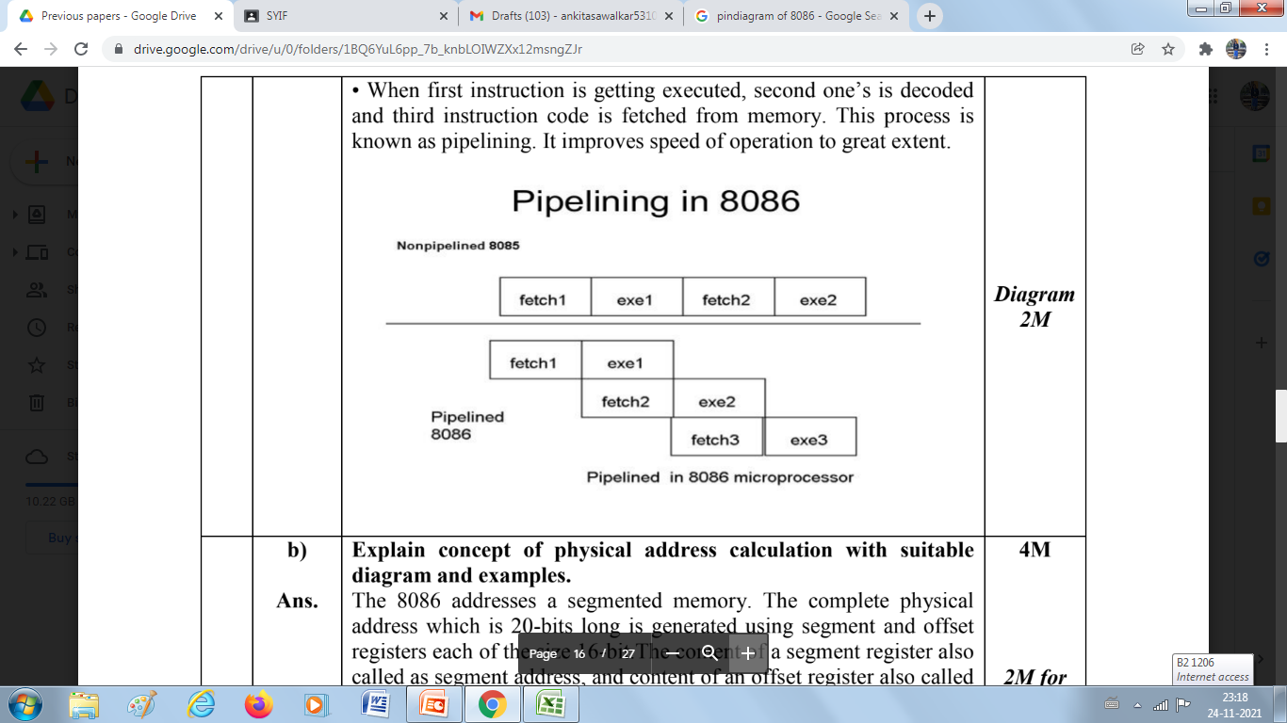
CONCEPT OF PIPELINING.
In pipelined processor, fetch, decode and execute operation are performed simultaneously or in parallel.
When first instruction is being decoded, same time code of the next instruction is fetched.
When first instruction is getting executed, second one's is decoded and third instruction code is fetched from memory.
This process is known as pipelining.
It improves speed of operation to great extent.

Slide 28
IMPORTANCE OF PIPELINING IN 8086
In pipelining, while the current instruction is executing, next instruction is fetched using a queue.
Pipelining enables many instructions to be executed at the same time.
It allows execution to be done in fewer cycles.
Speed up the execution speed of the processor.
More efficient use of processor.

Slide 29
Types of microprocessor.
CISC (Complex Instruction Set Computer):
CISC stands for “Complex Instruction Set Microprocessors”. CISC has to contain the complex instructions set, and due to that reason CISC take couple to time for executing all instructions, hence its speed more slow to RISC. Main goal of CISC is developed for various activities such as download, upload, and swap data between the memory card and other devices which are connected with computer.

Slide 30
RISC (Reduced Instruction Set Computer):
RISC means to “Reduced Instruction Set Computer”. Main objective of designing RISC is to decrease execution time that is simplified by the computer’s instructions. RISC has to use just one clock cycle for producing the result on uniform execution time. RISC needs more couples of RAM memory to save all instructions, due to this reason decrease the efficiency for all codes which are used in the lines form.

Slide 31
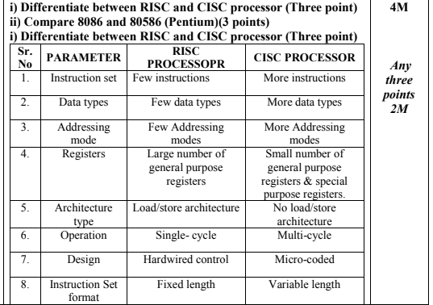

Slide 32
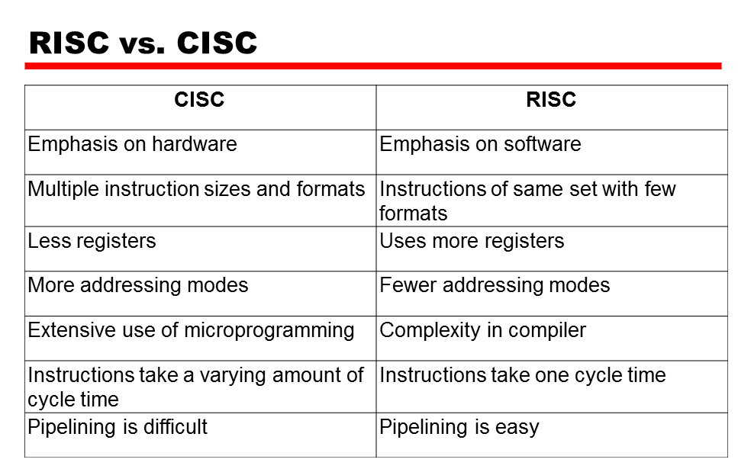

Slide 33
Assignment No 7
Day 1
Define Microprocessor.2m
Write applications of Microprocessor.2m
Write all features of Microprocessor 8086.4m
Draw the architecture of 8086.4m
Explain EU and BIU in detail. 4m
Explain Flag Register of 8086.4m
Draw Register Structure of 8086.2m
Draw Pin diagram of 8086.
Explain the concept of Pipelining.
Compare CISC and RISC 4m

